Slide 1
MTH1202 – Calculus I
Limits and Continuity

Slide 2
Overview
Rates of change
Limits
Limits Rules
Epsilon – delta definition of limits
Extension of limits

Slide 3
Rates of Change

Slide 5

Limits: Introduction
How does the function values behave in the neighborhood of $x_{o}$?

Slide 7
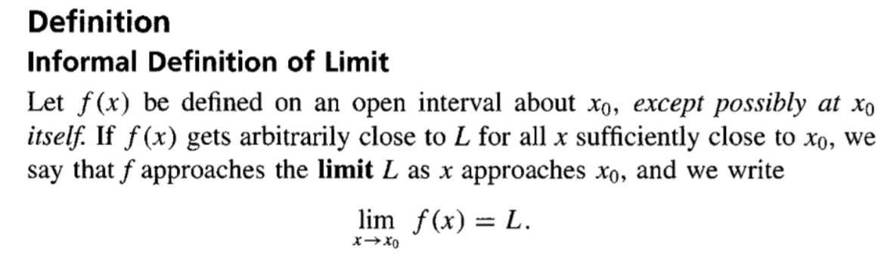

Slide 9
No Limit?

Slide 11
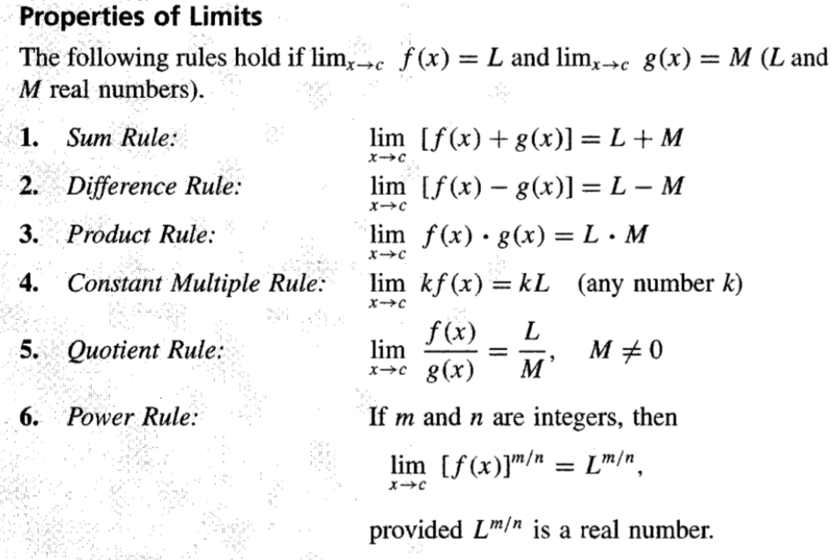

Slide 14
Asymptotes and Eliminating zero/factors

Slide 17
Epsilon-delta Notation

Slide 19
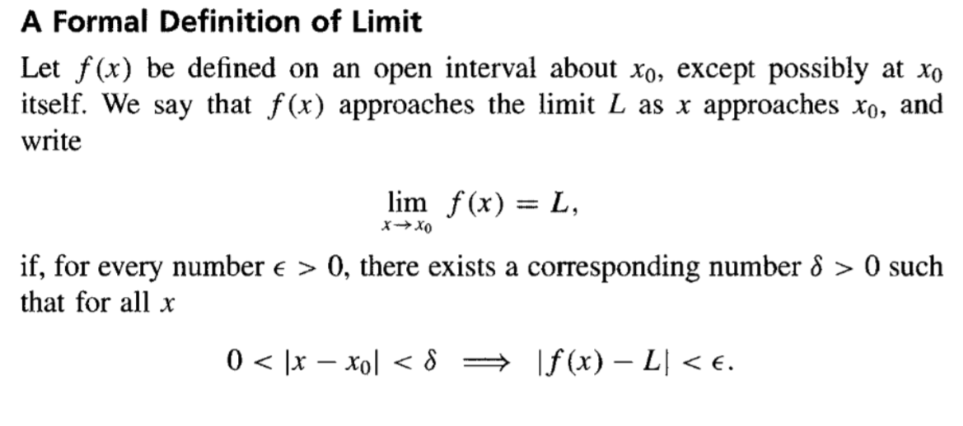

Slide 20

Left-hand & Right-hand Limits
$$\lim_{x→a+}{f(x)}=L$$
$$\lim_{x→a^{−}}{f(x)}=M$$

Slide 21
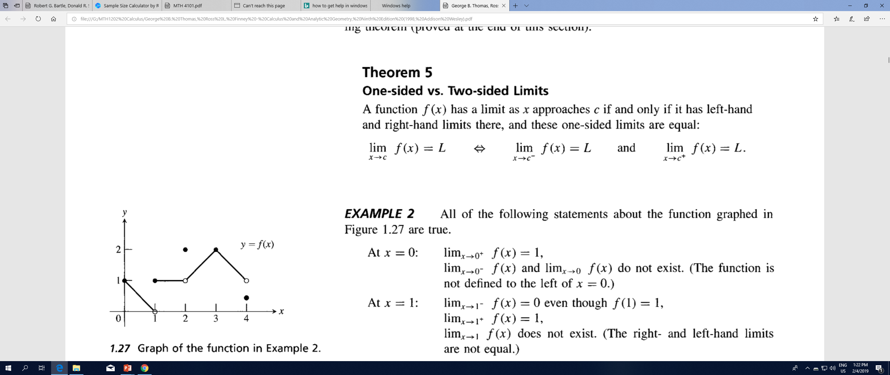

Slide 24
